Slide 1
Sito di aste Online
Versione THIN CLIENT
(HTML pura)
STUDENTE : DEAN NICOLA
Mat:911817
nicola.dean@mail.polimi.it

Slide 2
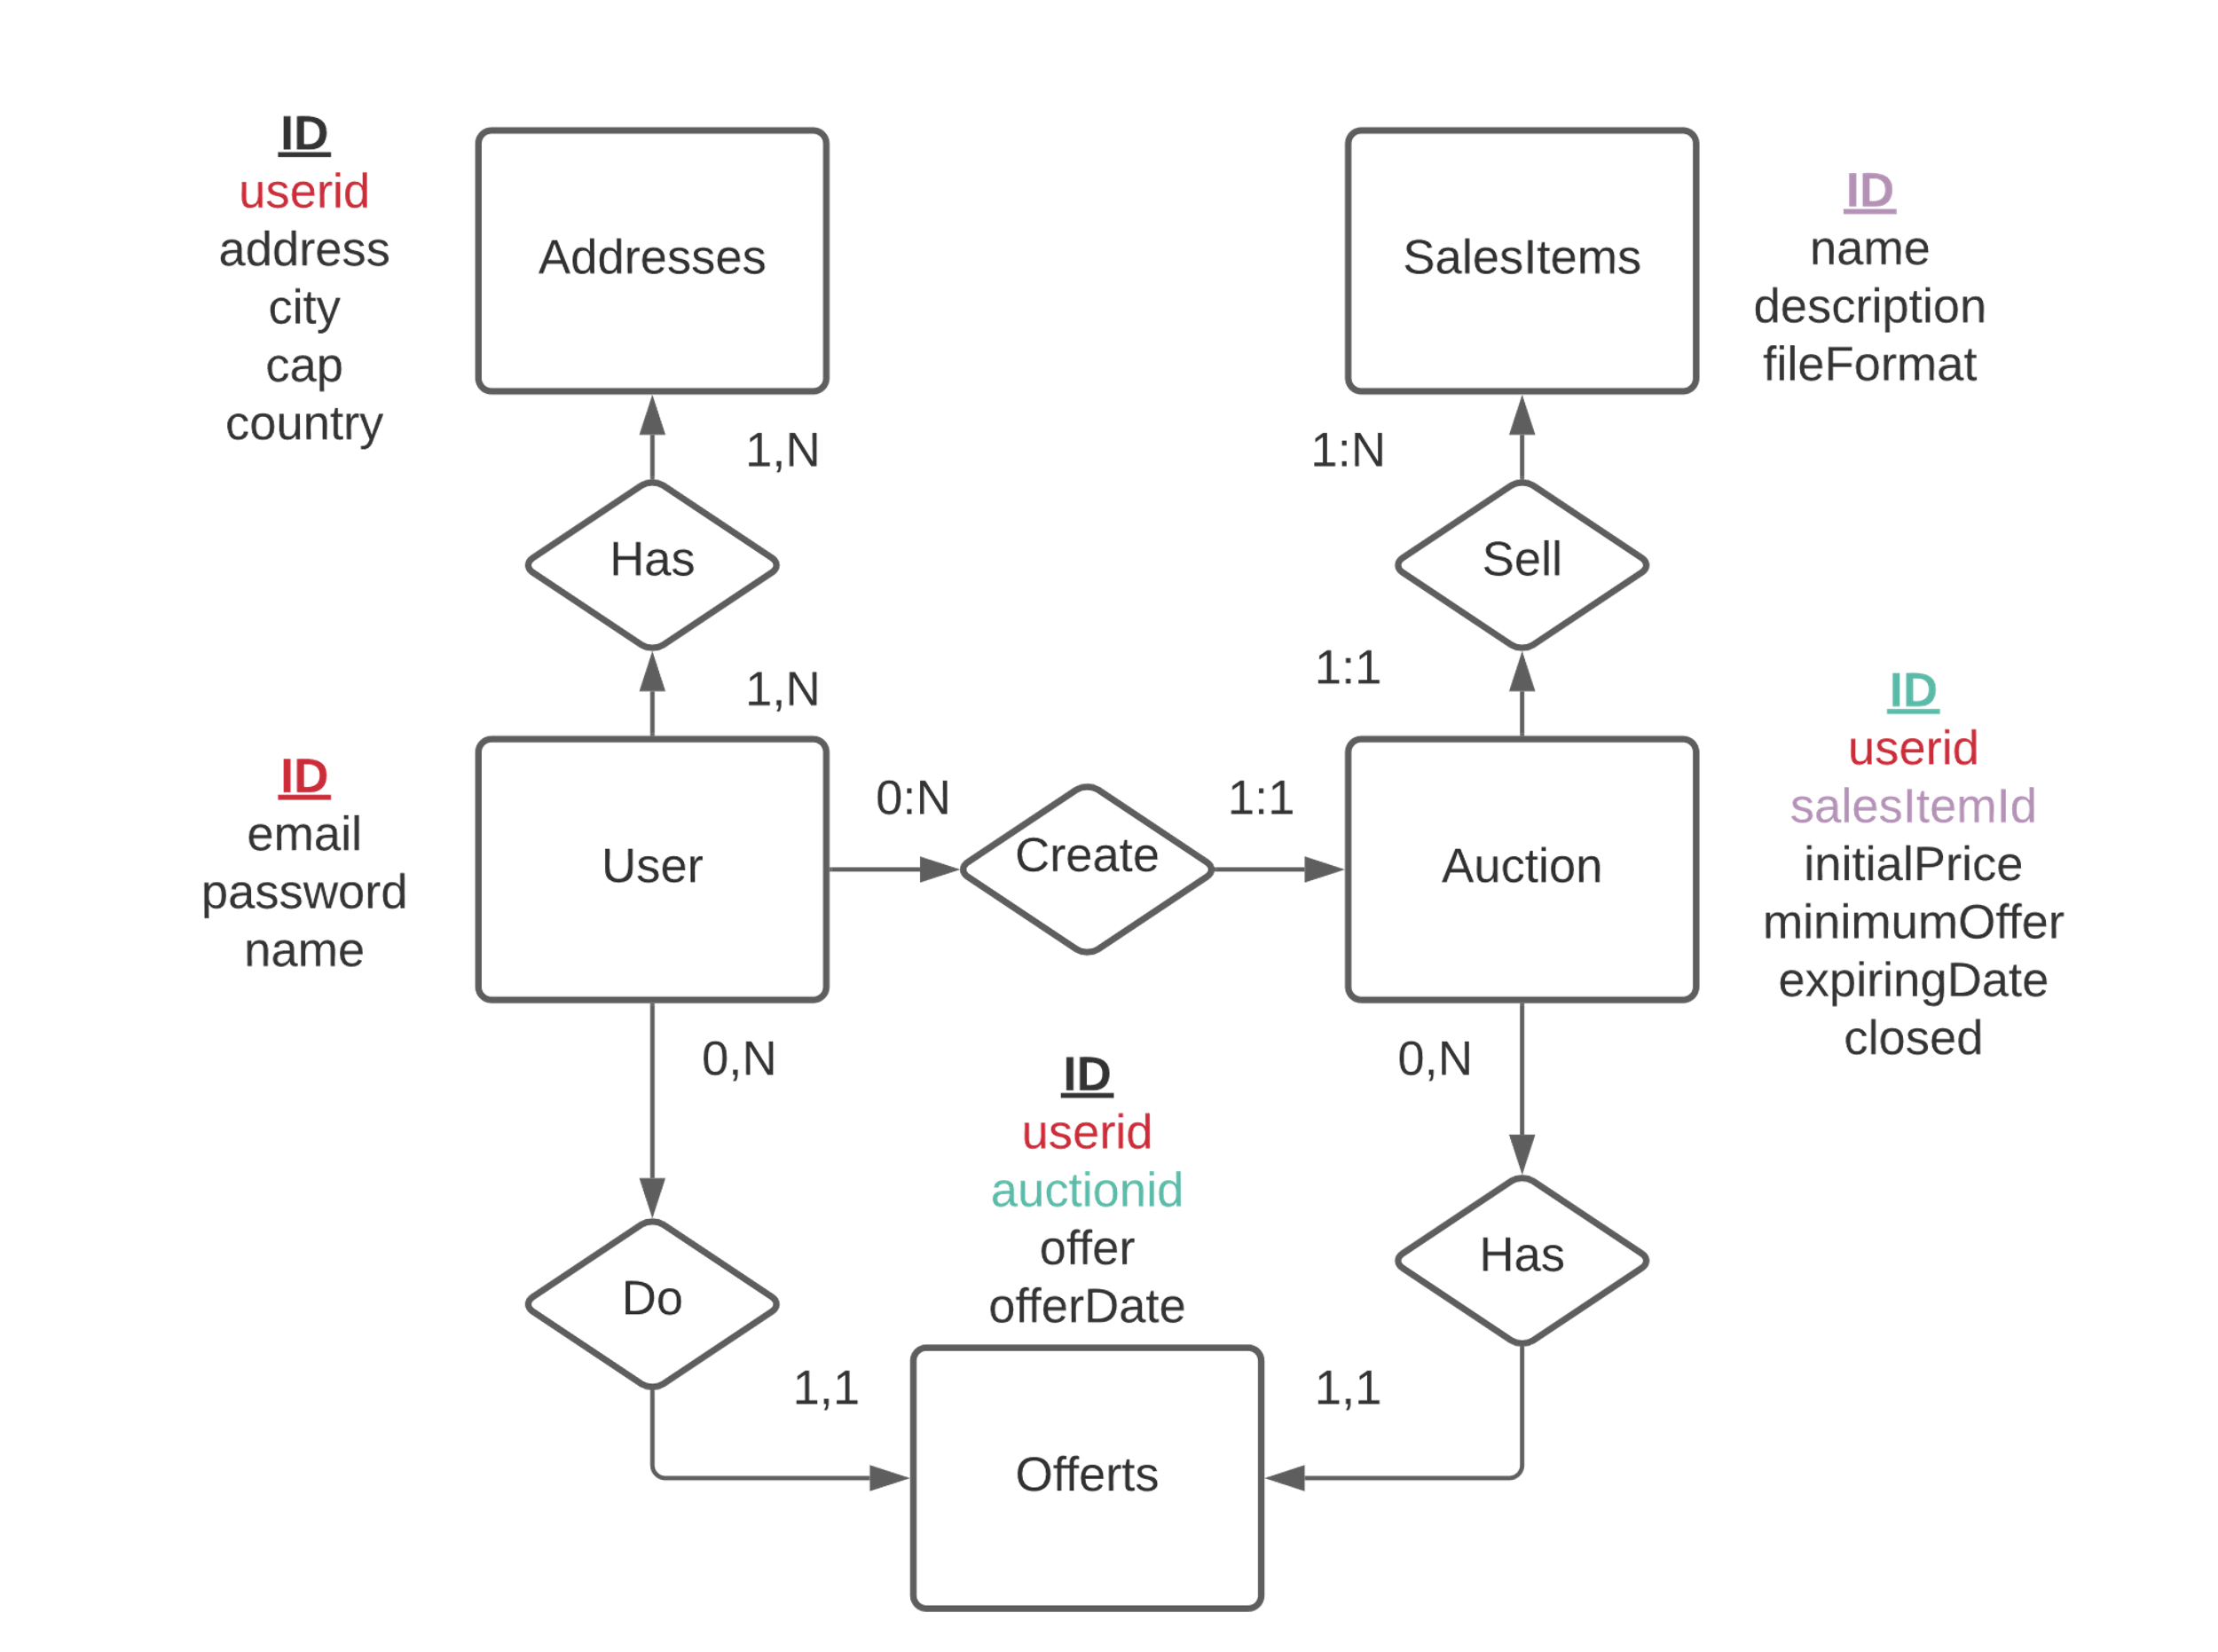
Diagramma Tabelle Database

Slide 3
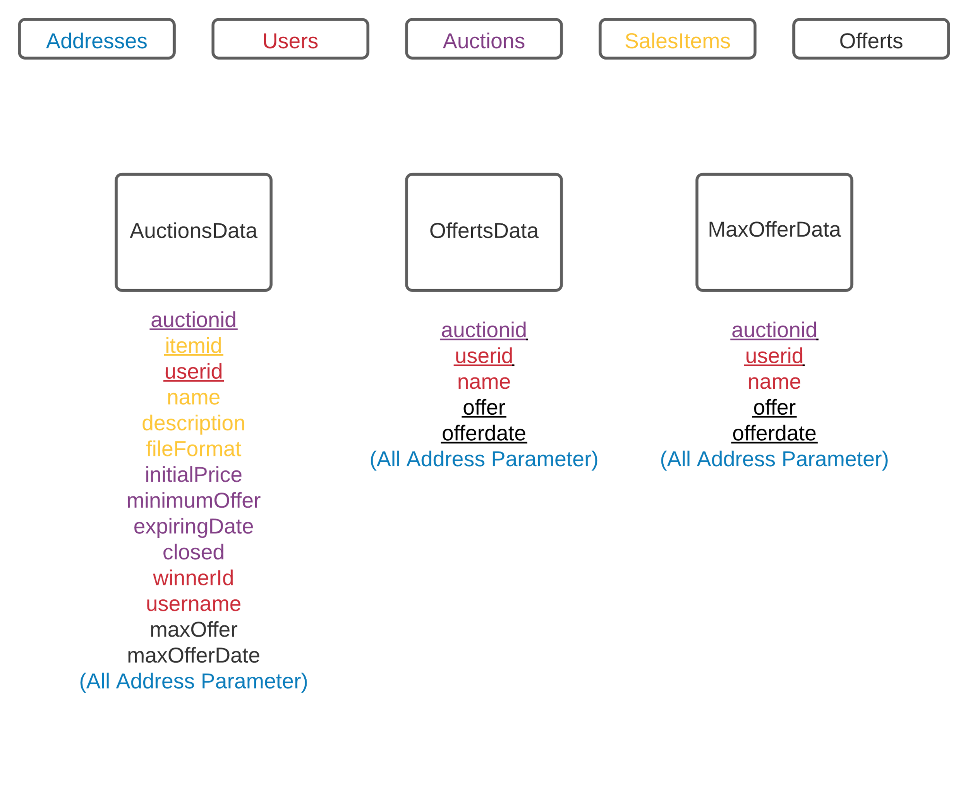
Diagramma View Database

Slide 4
CREATE TABLE users(
id int NOT NULL AUTO_INCREMENT,
email varchar(20),
password varchar(20),
name varchar(20),
PRIMARY KEY(id)
);
CREATE TABLE salesItems(
id int NOT NULL AUTO_INCREMENT,
name varchar(20),
description varchar(100),
fileFormat varchar(10),
PRIMARY KEY(id)
);
CREATE TABLE auctions(
id int NOT NULL AUTO_INCREMENT,
userid int,
salesItemid int,
initialPrize int,
minimumOffer int,
expiringDate datetime,
closed boolean,
PRIMARY KEY(id),
FOREIGN KEY (userid) REFERENCES users(id)
ON DELETE CASCADE ON UPDATE CASCADE,
FOREIGN KEY (salesItemid) REFERENCES salesitems(id) ON DELETE CASCADE ON UPDATE CASCADE
);

Slide 5
CREATE TABLE offerts(
id int NOT NULL AUTO_INCREMENT,
userid int,
auctionsid int,
offer int,
offerDate TIMESTAMP,
PRIMARY KEY(id),
FOREIGN KEY (userid) REFERENCES users(id)
ON DELETE CASCADE ON UPDATE CASCADE,
FOREIGN KEY (auctionsid) REFERENCES auctions(id) ON DELETE CASCADE ON UPDATE CASCADE
);
create table addresses(
id int NOT NULL AUTO_INCREMENT,
userid int,
address varchar(20),
city varchar(20),
cap int,
country varchar(3),
PRIMARY KEY(id),
FOREIGN KEY (userid) REFERENCES users(id)
ON DELETE CASCADE ON UPDATE CASCADE
);

Slide 6
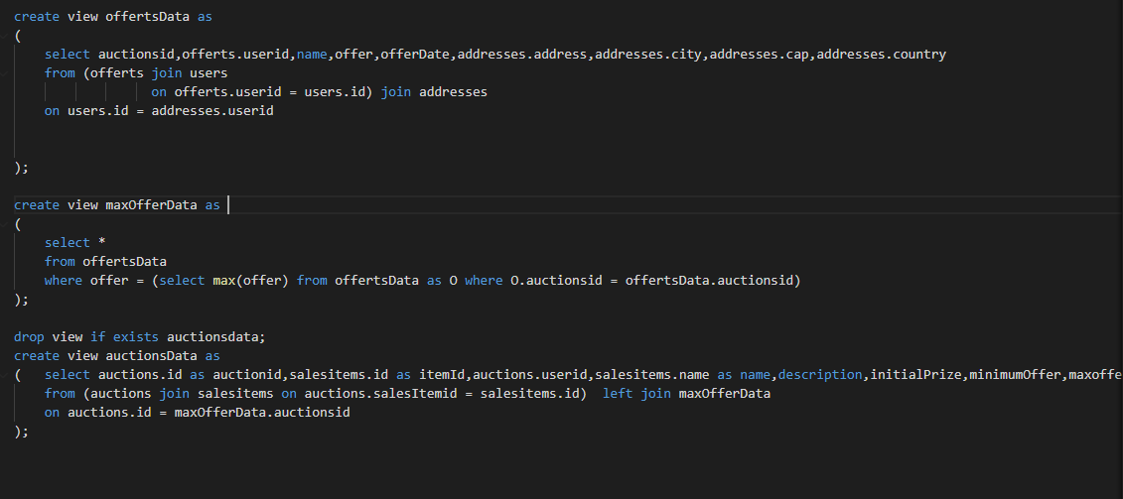

Slide 8
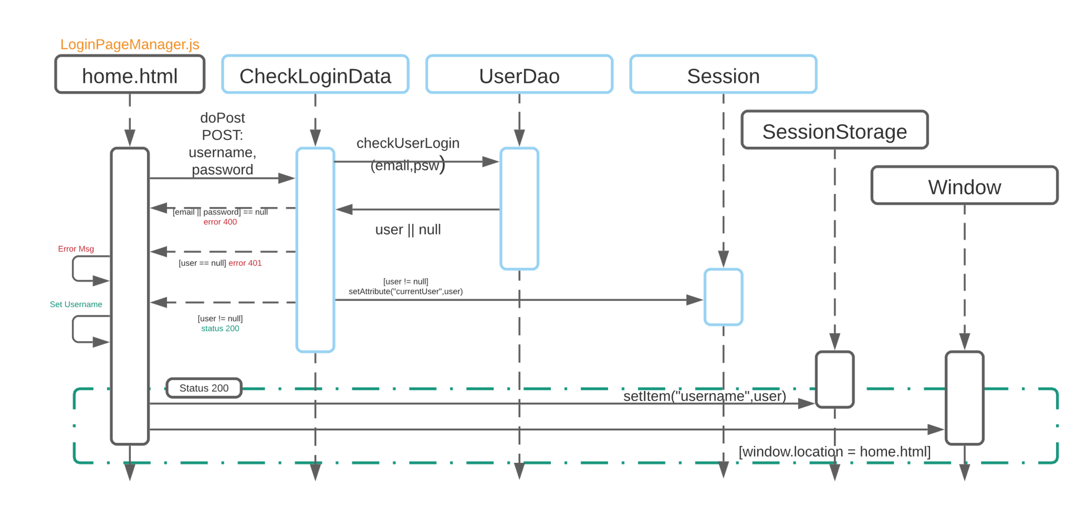
Evento Di Login

Slide 9
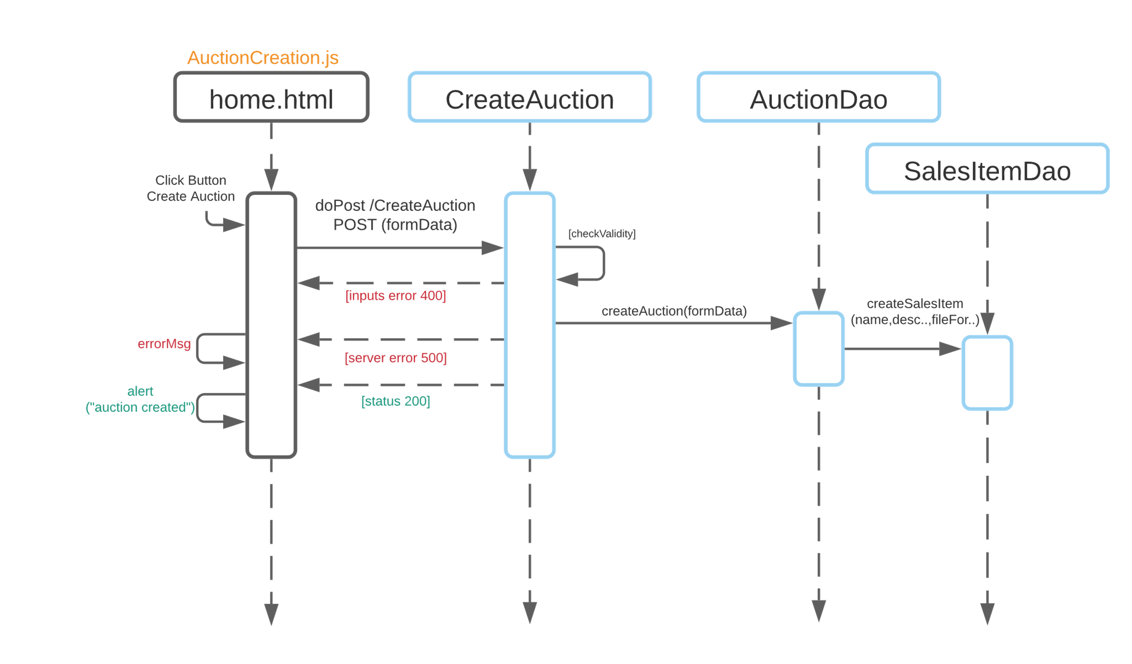
Evento Di Creazione Asta

Slide 10
Evento Di Creazione Offerta

Slide 11
Evento Di Caricamento UserPage

Slide 12
Evento Di Stampa Lista Aste

Slide 13
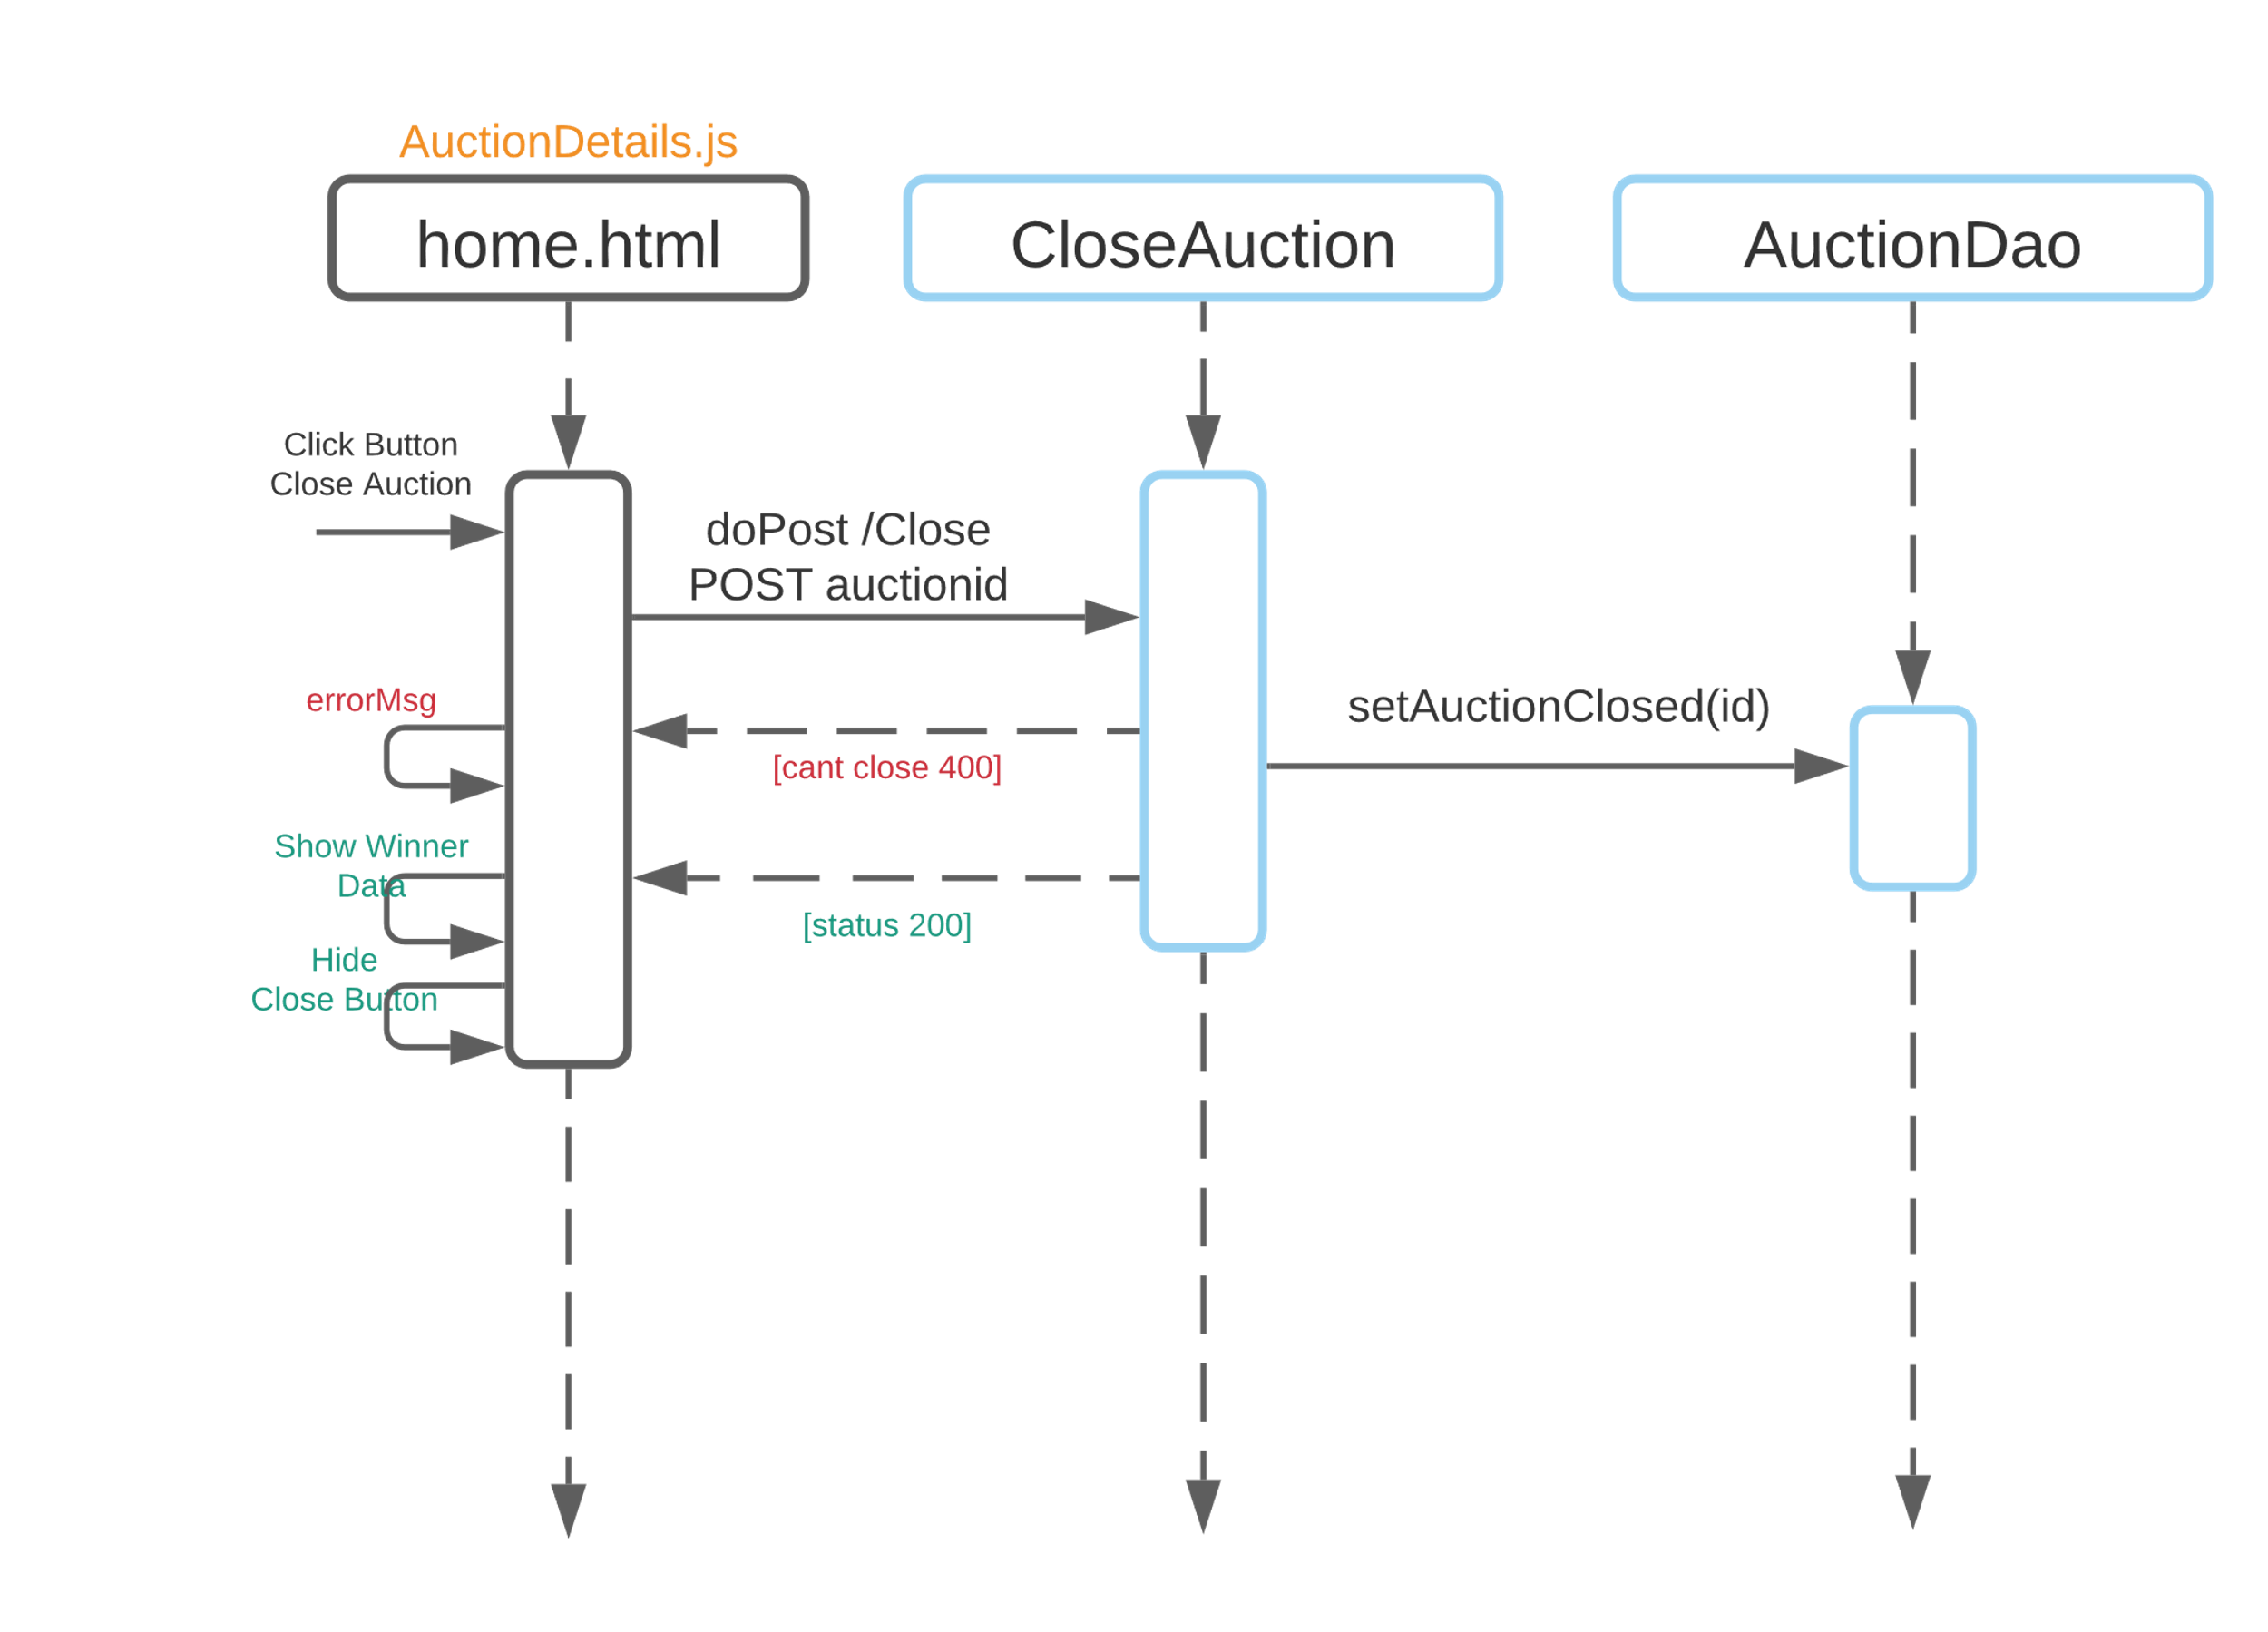
Evento Di Chiusura Asta

Slide 14
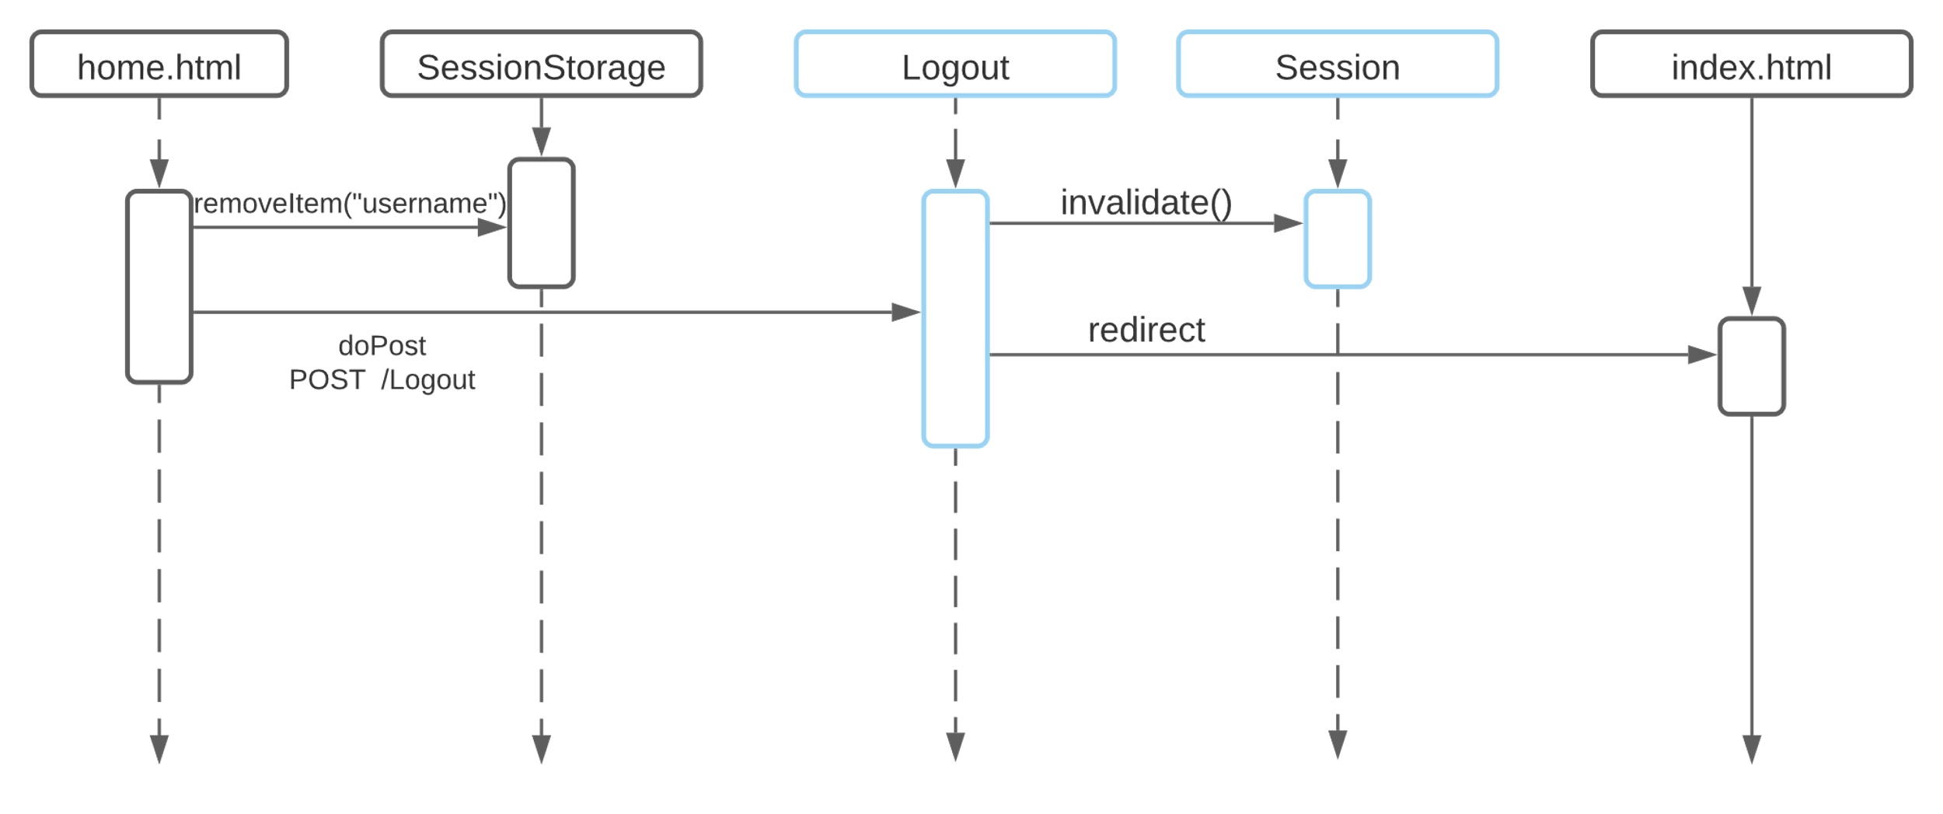
Evento Di Logout

